Slide 1
Spatial Data Structures Reading Session: Quad Trees (Samet 1.4)
By Victor Lu

Slide 2
Motivation for Studying Quad Trees
Allows efficient querying of points in multidimensional space by pruning the search space.
Applications:
  Photon Mapping
  Point Cloud Processing

Slide 3
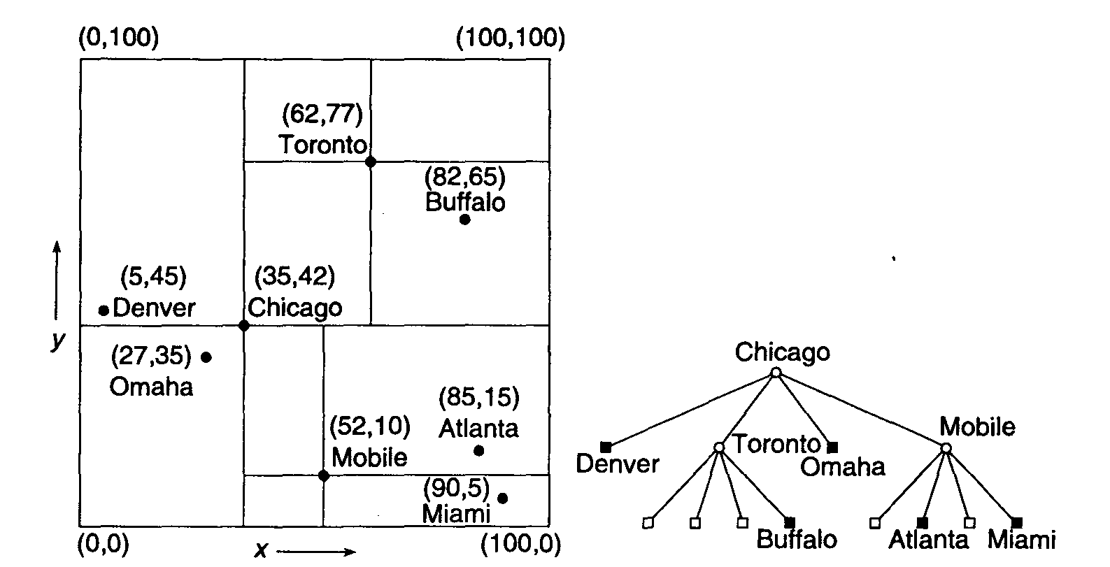
Point Quadtrees
Point of decomposition at data points.

Slide 4
Point Quadtree: Insertion (1.4.1.1)
Order of data point insertion matters:
Unbalanced Point Quadtree
Optimized Point Quadtree
1
1
1
2
2
2
3
3
3
4
4
4
1
2
2
1
3
3
4
4
An optimized point quadtree is constructed such that for any node x, the number of nodes in any of its quadrants will not exceed half the total number of nodes in the subtree rooted at x.
Procedure for constructing optimized point quadtrees: (1) Sort points by x-value. (2) Assign median point m as root of tree. (3) By choosing m, remaining points get divided into 4 groups. (4) Repeat procedure on each group.

Slide 5
Point Quad Tree: Deletion (1.4.1.2)
Naïve Approach: Remove node x and re-insert nodes in subtree(x). This is supposedly very inefficient.
Smart approach: Described in 1.4.1.2 of text. General idea is to pick a replacement node that minimizes the number of nodes requiring re-insertion. As illustrated below, in a good scenario, we only need to replace node x without having to restructure the tree.
Want to delete this

Slide 6
Point Quadtree: Search (1.4.1.3)
Technique for pruning search space: Based on the location of the root, we can safely ignore certain quadrants
1
2
3
9
10
4
5
1
11
12
6
7
8
Root Position | 1 | 2 | 3 | 4 | 5 | 6 | 7 | 8 | 9 | 10 | 11 | 12 | 13
Quadrants to Search | SE | SE SW | SW | SE NE | SW NW | NE | NE NW | NW | SE SW NE | SE SW NW | SE NE NW | SW NE NW | SE SW NE NW

Slide 7
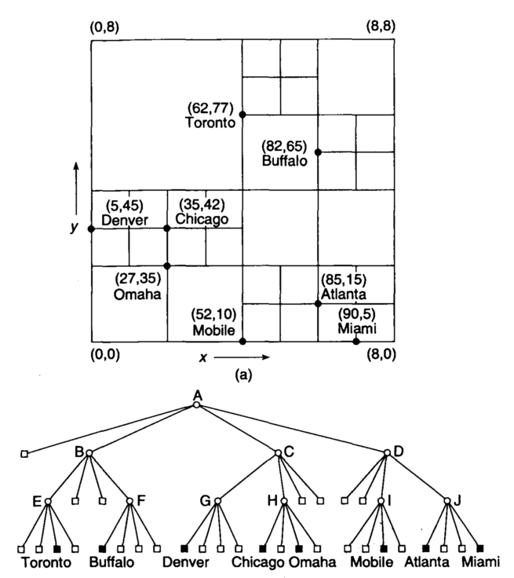
MX Quad Trees
Used for representing data points living in a discrete domain (eg. 8 x 8 grid)
All data points reside at same level
Suitable for representing sparse matrices, hence the name MX

Slide 8
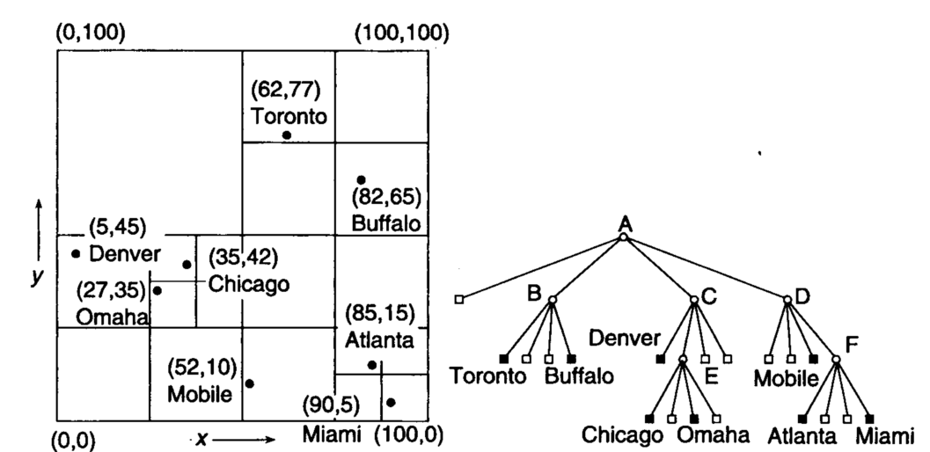
PR (Point Region) Quad Trees
Space subdivided repeatedly into congruent quadrants until all quadrants contain no more than one data point
The bucket PR quadtree allows no more than some b > 1 number of data points per quadrant

Slide 9
Quadtree Comparison
Point Quadtree
  Pros:
    Compact, because number of tree nodes equals number of data points
    Shorter search paths (~log₄N) compared to kd-trees (~log₂N)
  Cons:
    Deletion of a node involves finding a suitable replacement and rearranging the nodes of its subtree.
    Tree shape depends on order of data point insertion. Inserting at arbitrary order may result in unbalanced trees.
PR Quadtree
  Pros:
    Tree shape independent of order of data point insertion. It depends only on arrangement of data points in space
    Deletion is straightforward, since all data points reside in leaf nodes.
  Cons:
    Certain quadrants may require many subdivisions to separate densely clumped points, leading to a deep search paths.

Slide 10
Quadtree Comparison
 | Point Quadtree | MX Quadtree | PR Quadtree
Min Depth | ⎡log₄((3N+1)/4)⎤ | ? | log₄N
Max Depth | N-1 | ? | ⎡log₂((s/d)√2⎤
Insert Time | ? | ? | ?
Deletion Time | ? | ? | ?
Search Time | ? | ? | ?

Slide 11
Some Relevant References
Samet’s webpage: Contains a cool Java Applet showing how various data structures work. http://donar.umiacs.umd.edu/quadtree/
D.T. Lee and C. K. Wong. Worst-Case Analysis for Region and Partial Region Searches in Multidimensional Binary Search Trees and Balanced Quad Trees
Samet. Deletion in Two-Dimensional Quad Trees
Finkel and Bentley. Quad Trees: A Data Structure for Retrieval on Composite Keys.
Wikipedia

